Slide 1

Linux Plus
for
AWS and DevOps
Session - 5

Slide 2


Slide 3
Table of Contents
Review
Shell
Bash
Bash Prompt
Shell Scripts

Slide 4

1

Slide 5
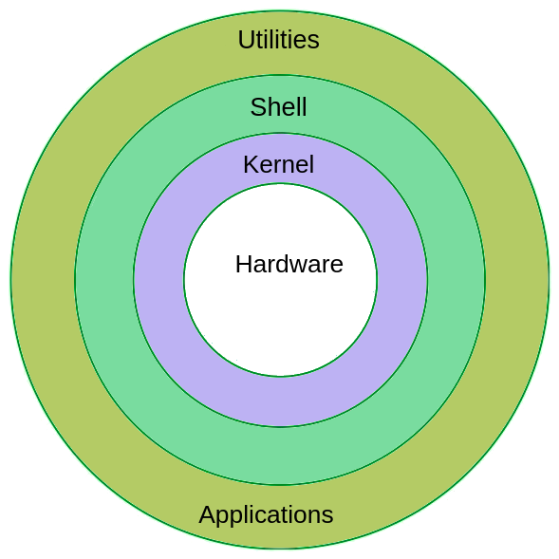
Components of Linux
USER
USER
Notes:
Kernel: It is the core part of the Linux system. It interacts with the hardware. It manages various components like the CPU, peripheral devices, and memory.
Shell: The Shell is an interface between the user and the Kernel. It takes user commands through the Terminal and processes the particular request.
Commands and Utilities: The Linux operating system comes with a Terminal that users can use to pass commands to the Shell. One simple command is the ‘ls’ which shows the contents of a folder
For understanding the components, First you need to understand what a computer operating system or OS is. As I’ve stated earlier, an OS is the computer code which manages the hardware in a physical computer. It exists as a layer between your software and your hardware. Most people writing software do not want to know how to address a CPU in assembler, or how to communicate with a graphics card. An OS such as Linux or Windows acts as a middleman.
Every OS has component parts, and the Linux also has the following components:
OS Kernel. You can call the kernel the part of the operating system which is the “closest” to your computing hardware as it is the part which controls the CPU, access to memory and any peripheral devices. It is the “lowest” level at which your operating system works.
OS Shell. You need to be able to tell our operating system what to do, and this is the goal of the shell. Also known as the command line, it is a facility which lets you instruct your OS using text. However few people nowadays are familiar with command line code, and it once used to put people off using Linux. This changed because a modern distribution of Linux will use a desktop shell just like Windows.
It’s worth noting that Ubuntu’s application repository, the Ubuntu software centre, is a great place to look around for Linux applications, both free to use and paid to use.

Slide 6
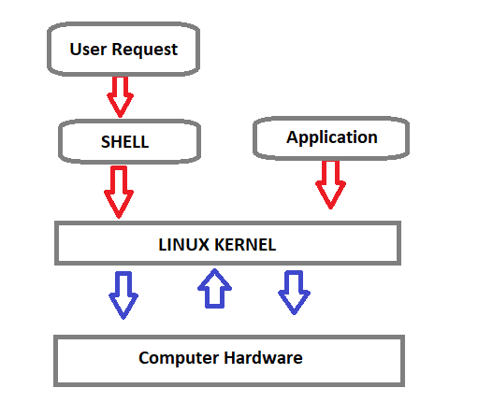
What is SHELL?
Shell is a program that receives the user's commands and gives them to the operating system to process and displays the output.
The standard Linux shell is both a command-line interpreter and a programming language.
Notes:
Shell is a program that receives the user's commands and gives them to the operating system for processing and displaying the output. We use the Shell through the CLI (command-line interface).

Slide 7
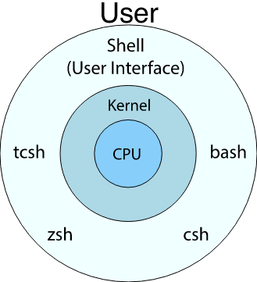

Shell
SH
Bourne-Again SHell

Slide 8
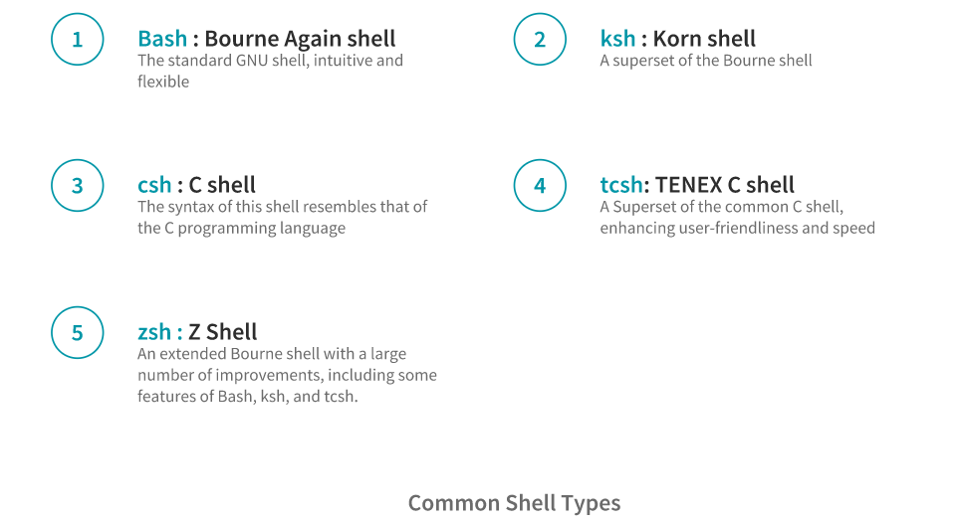
Shell

Slide 9
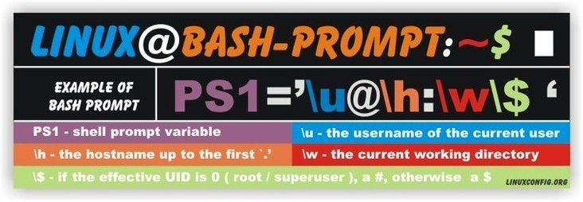
2

Slide 10
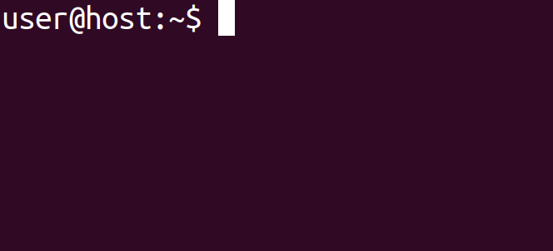
The Bash prompt
A prompt is text or symbols used to represent the system's readiness to perform the next command.
PS1 variable stands for "Prompt String One" and represents the primary prompt string.
Notes:
Simply put, a command prompt is an input field in the terminal emulator (CLI) which lets you input/issue commands. The command prompt provides some useful information to the user.

Slide 11
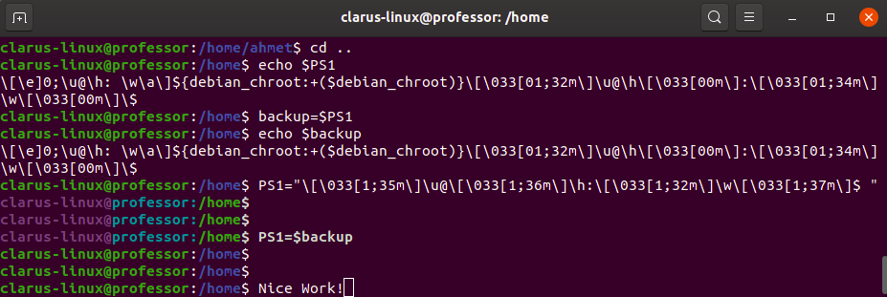
The Bash prompt
BASH prompt can be easily changed by modifying bash PS1 variable.

Slide 12
The Bash prompt
Bash prompt can be customized by using special characters. Here is the most used characters and their meaning.
Special Character | Explanation
\d | The date in "Weekday Month Date" format (e.g., "Sun Apr 12")
\h | the hostname up to the first `.'
\H | the hostname
\s | the name of the shell, the basename of $0 (the portion following the final slash)
\t | the current time in 24-hour HH:MM:SS format
\T | the current time in 12-hour HH:MM:SS format
\@ | the current time in 12-hour am/pm format
\u | the username of the current user

Slide 13
The Bash prompt
Bash prompt can be customized by using special characters. Here is the most used characters and their meaning.
Special Character | Explanation
\v | the version of bash (e.g., 2.00)
\V | the release of bash, version + patch level (e.g., 2.00.0)
\w | the current working directory
\W | the basename of the current working direc­tory
\! | the history number of this command

Slide 14

Homework
How can we make permanent our changes in PS1

Slide 15

Shell Scripts
3

Slide 16
Shell Scripts
What is Shell Scripting?
Shell Scripting is an open-source computer program designed to be run by the Unix/Linux shell which could be one of the following:
The Bourne Shell
The C Shell
The Korn Shell
The GNU Bourne-Again Shell

Slide 17
Shell Scripts
What is Shell Scripting?
Typical activities that can be done in a shell, such as file manipulation, program execution, and printing text, can also be done with the shell script.
Lengthy and repetitive sequences of commands can be combined into a single script that can be stored and executed anytime.

Slide 18
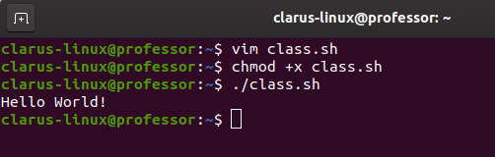

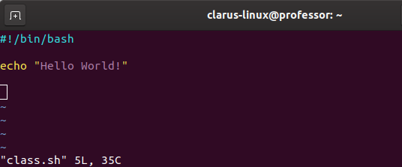
Shell Scripts
Shebang (#!)
Notes:
Before we add anything else to our script, we need to alert the system that a shell script is being started.
This is done specifying `#!/bin/bash` on the first line, meaning that the script should always be run with bash, rather than another shell.
It's called a `shebang` because the `#` symbol is called a hash, and the `!` symbol is called a bang.

Slide 19

Shell Scripts
chmod
Notes:
After to save the script file, we need to make the script executable.

Slide 20
Shell Scripts
“./”
Notes:
./class.sh means we're calling something in the current working directory. In this case class.sh is an executable. We have to specify the path for executables if they're outside our $PATH variable and that's why class.sh isn't enough.

Slide 21
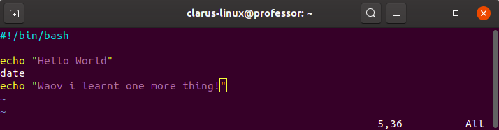
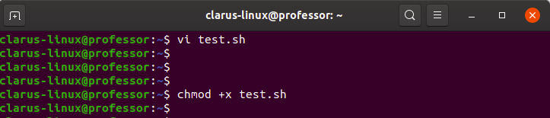
Shell Scripts

Slide 22

Exercise 1
Create a script named: “my-first-script.sh”
It should print: “This is my first script.”
Make the script executable.
Execute the script.
Notes:
🍐 This is a Pear Deck Text Slide
🍐 To edit the type of question, go back to the "Ask Students a Question" in the Pear Deck sidebar.
vim my-first-script.sh
#!/bin/bash
echo “This is my first script.”
chmod +x my-first-script.sh
./my-first-script.sh

Slide 23
Homework
Create an environment that you don’t need to provide “./” before your scripts while executing them.

Slide 24
Variables
A variable is pointer to the actual data. The shell enables us to create, assign, and delete variables.
The name of a variable can contain only letters (a to z or A to Z), numbers ( 0 to 9) or the underscore character (_) and beginning with a letter or underscore character.
The reason you cannot use other characters such as !, *, or - is that these characters have a special meaning for the shell.
$VARIABLE=value
$echo $VARIABLE
value
$
$my_var=my_value
$echo $my_var
my_value
$
$my-var=my-value
my-var=my-value: command not found
$
$myvar?=my-value
myvar?=my-value: command not found

Slide 25
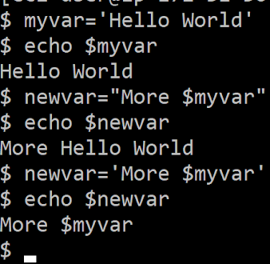
Variables
variable=value
This is one of those areas where formatting is important. Note there is no space on either side of the equals ( = ) sign. We also leave off the $ sign from the beginning of the variable name when setting it.
sampledir=/etc
ls $sampledir

Slide 26
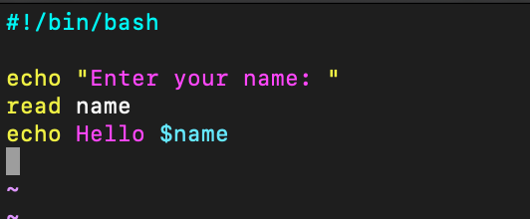
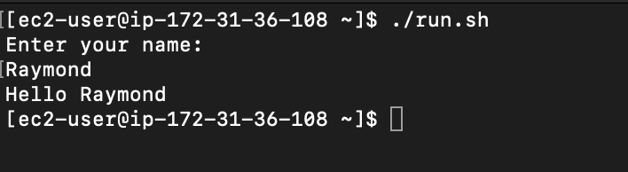
Console input
read [variable-name]
Notes:
The Bash `read` command is a powerful built-in utility used take user input.

Slide 27
Console input
read
#!/bin/bash
read -p "Enter Your Name: " username
echo "Welcome $username!"
#!/bin/bash
echo What cars do you like?
read car1 car2 car3
echo Your first car was: $car1
echo Your second car was: $car2
echo Your third car was: $car3
#!/bin/bash
read -s -p "Enter Password: " pswd
echo $pswd
#!/bin/bash
read -sp "Enter Password: " pswd
echo $pswd
Notes:
When writing interactive bash scripts, we can use the read command to get the user input. To specify a prompt string, use the -p option. The prompt is printed before the read is executed and doesn’t include a newline.
When entering sensitive information we do not want to display input coming. For this we can use `read -s`

Slide 28

Command Line Arguments
$0 - The name of the Bash script.
$1 - $9 - The first 9 arguments to the Bash script.
$# - How many arguments were passed to the Bash script.
$@ - All the arguments supplied to the Bash script.
$? - The exit status of the most recently run process.
$$ - The process ID of the current script.
$USER - The username of the user running the script.
$HOSTNAME - The hostname of the machine the script is running on.
$SECONDS - The number of seconds since the script was started.
$RANDOM - Returns a different random number each time is it referred to.
$LINENO - Returns the current line number in the Bash script.

Slide 29
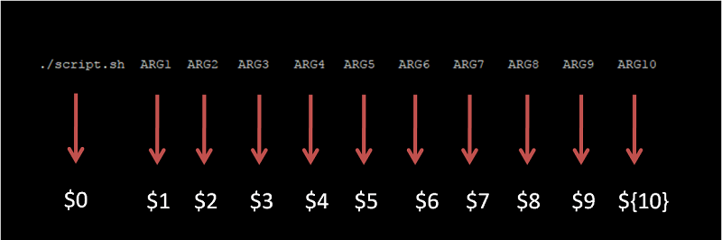
Command Line Arguments
Notes:
Command-line arguments are given after the name of the program in command-line shell of Operating Systems.
The command-line arguments $1, $2, $3, ...$9 are positional parameters, with $0 pointing to the actual command, program, shell script, or function and $1, $2, $3, ...$9 as the arguments to the command.

Slide 30
Simple Arithmetic
expr command print the value of expression to standard output.
expr item1 operator item2
let is a builtin function of Bash that helps us to do simple arithmetic. It is similar to expr except instead of printing the answer it saves the result to a variable.
let <arithmetic expression>
We can also evaluate arithmetic expression with double parentheses.
$((arithmetic expression))
Notes:
#!/bin/bash
# Basic arithmetic using let
let a=5+4
echo $a # 9
let "a = 5 + 4"
echo $a # 9
let a++
echo $a # 10
let "a = 4 * 5"
echo $a # 20
let "a = $1 + 30"
echo $a # 30 + first command line argument
*****************
#!/bin/bash
# Basic arithmetic using expr
expr 5 + 4
expr "5 + 4"
expr 5+4
expr 5 \* $1
expr 11 % 2
a=$( expr 10 - 3 )
echo $a # 7
***********************
#!/bin/bash
# Show the length of a variable.
a='Hello World'
echo ${#a} # 11
b=4953
echo ${#b} # 4

Slide 31
Arithmetic Expressions
expr item1 operator item2
#!/bin/bash
first_number=8
second_number=2
echo "SUM="`expr $first_number + $second_number`
echo "SUB="`expr $first_number - $second_number`
echo "MUL="`expr $first_number \* $second_number`
echo "DIV="`expr $first_number / $second_number`
$ chmod +x cal.sh
$ ./cal.sh
SUM=10
SUB=6
MUL=16
DIV=4

Slide 32
Arithmetic Expressions
let [expression]
#!/bin/bash
number1=8
number2=2
let total=number1+number2
let diff=number1-number2
let mult=number1*number2
let div=number1/number2
echo "Total = $total"
echo "Difference = $diff"
echo "Multiplication = $mult"
echo "Division = $div"
$ ./run.sh
Total = 10
Difference = 6
Multiplication = 16
Division = 4

Slide 33
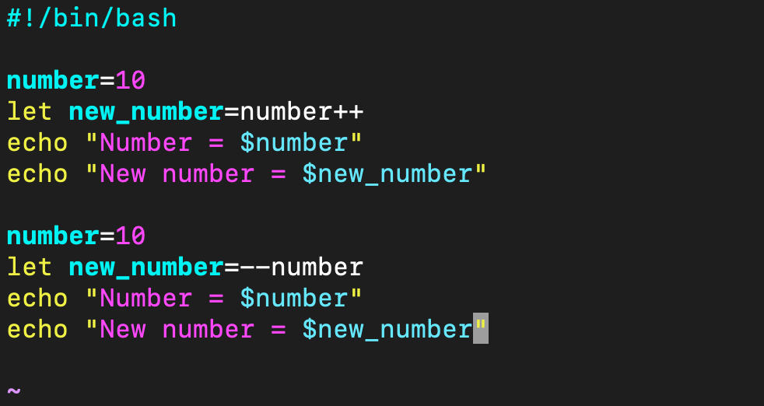
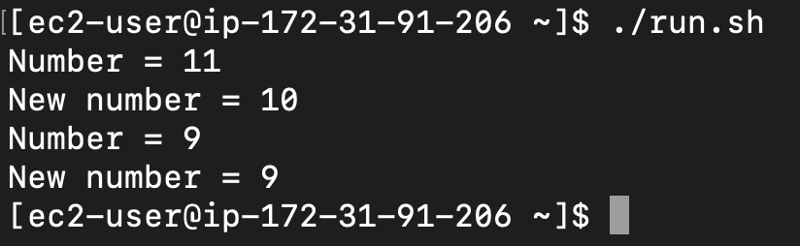
“num++” “++num” “num--” “--num”
Notes:
number++/– →>> assigned to new number after increase number
--/++number →>> decrease number after assigned to new number

Slide 34
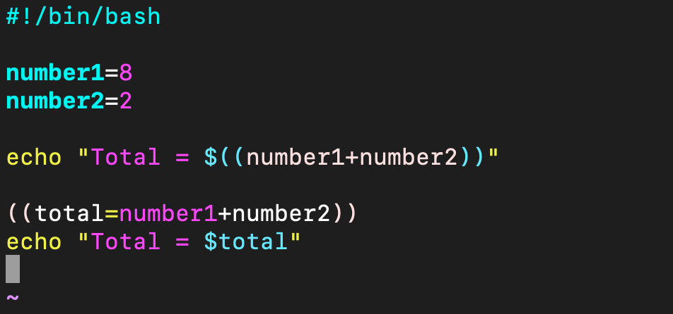
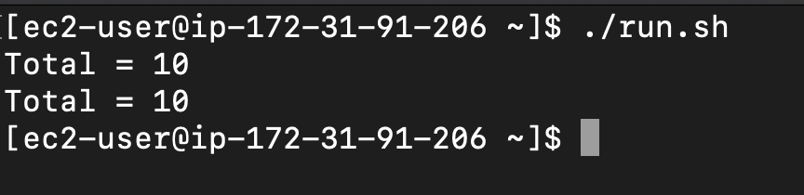
Arithmetic Expressions
$((Expression))
((Expression))

Slide 35
Exercise 1
Ask user to enter two numbers to variables num1 and num2.
Calculate the total of 2 numbers.
Print the total number and increase it by 1.
Print the new value of the total number.
Subtract num1 from the total number and print result.
Change the num1 and num2 variables to be passed from the Command line arguments instead of receiving them from the user
Notes:
🍐 This is a Pear Deck Text Slide
🍐 To edit the type of question, go back to the "Ask Students a Question" in the Pear Deck sidebar.

Slide 36
Exercise 2
Create a script named calculate.sh:
Create a variable named base_value with default value of 5
Request another number from user and assign it to user_input variable
Add user_value to the base_value and assign it to total variable
Print total to the screen with the message “Total value is: ”
Make the script executable.
Execute the script.
Notes:
🍐 This is a Pear Deck Text Slide
🍐 To edit the type of question, go back to the "Ask Students a Question" in the Pear Deck sidebar.

Slide 37
THANKS!
Any questions?

